Slide 1

Association Mining
GOA COLLEGE OF ENGINEERING
Affiliated to Goa University
INFORMATION TECHNOLOGY DEPARTMENT
Vision
Impart high quality knowledge and skills to students in the field of Information Technology ,motivate research, encourage industry consultancy projects and nurture human values and life skills.
Prepared By,
Ms. Diana Miranda
Assistant Professor
Dept. of Information Technology
Goa College of Engineering

Slide 2
Problem Definition
Given a set of transactions, find rules that will predict the occurrence of an item based on the occurrences of other items in the transaction
Implication means co-occurrence, not causality!
Market-Basket transactions
Example of Association Rules
{Diaper} → {Beer}, {Milk, Bread} → {Eggs,Coke}, {Beer, Bread} → {Milk},

Slide 3
Definition: Frequent Itemset
Itemset
A collection of one or more items
Example: {Milk, Bread, Diaper}
k-itemset
An itemset that contains k items
Support count (σ)
Frequency of occurrence of an itemset
E.g. What is σ({Milk, Bread,Diaper}) ?
Ans=2
Support
Fraction of transactions that contain an itemset
E.g. What is s({Bread, Diaper})?
Ans = 3/5
Frequent Itemset
An itemset whose support is greater than or equal to a minsup threshold

Slide 4
Definition: Association Rule
Let D be database of transactions
e.g.:
Let I be the set of items that appear in the database, e.g., I={A,B,C,D,E,F}
A rule is defined by X ⇒ Y, where X⊂I, Y⊂I, and X∩Y=∅
e.g.: {B,C} ⇒ {E} is a rule

Slide 5
Definition: Association Rule
Association Rule
An implication expression of the form X → Y, where X and Y are itemsets
Example: {Milk, Diaper} → {Beer}
Rule Evaluation Metrics
Support (s)
Fraction of transactions that contain both X and Y
Confidence (c)
Measures how often items in Y appear in transactions that contain X
Example:

Slide 6
Rule Measures: Support and Confidence
Find all the rules X ⇒ Y with minimum confidence and support
support, s, probability that a transaction contains {X ∪ Y}
confidence, c, conditional probability that a transaction having X also contains Y
Customer
buys both
Customer
buys diaper
Let minimum support be 50%, and minimum confidence be 50%, we have
Customer
buys beer
A ⇒ C
C ⇒ A
(50%, 66.6%)
(50%, 100%)

Slide 7
Example
TID date items_bought
100 10/10/99 {F,A,D,B}
200 15/10/99 {D,A,C,E,B}
300 19/10/99 {C,A,B,E}
400 20/10/99 {B,A,D}
Remember:
conf(X ⇒ Y) =
What is the support and confidence of the rule: {B,D} ⇒ {A}
Support:
percentage of tuples that contain {A,B,D} =
75%
Confidence:
100%

Slide 8
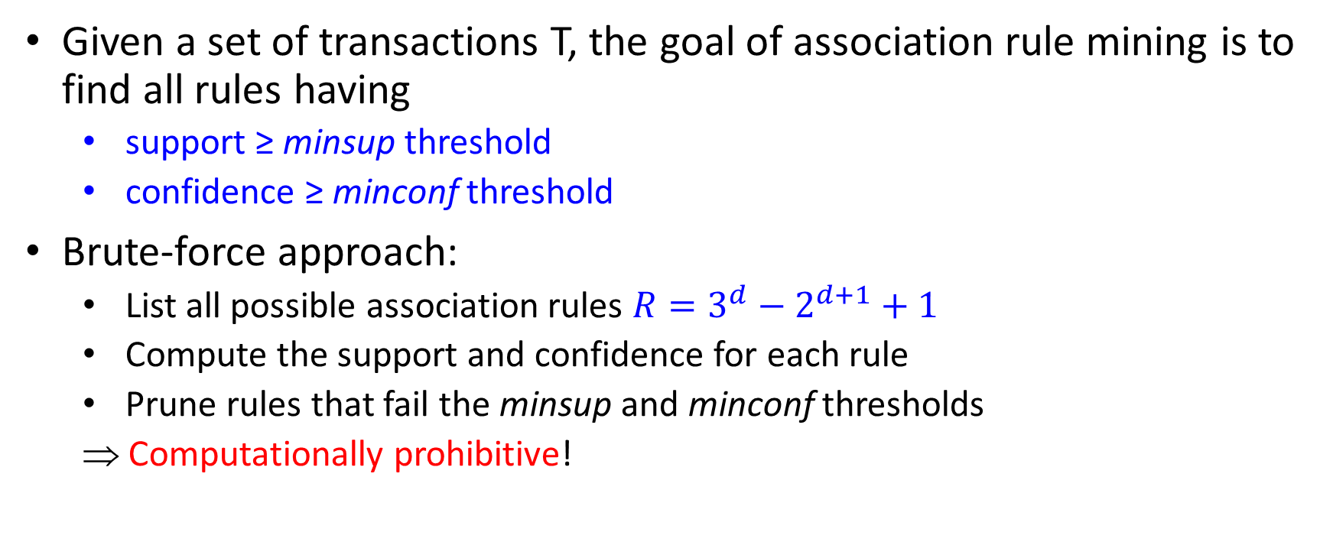
Association Rule Mining Task
Given a set of transactions T, the goal of association rule mining is to find all rules having
support ≥ minsup threshold
confidence ≥ minconf threshold
Brute-force approach:
List all possible association rules $R=3^{d}−2^{d+1}+1$
Compute the support and confidence for each rule
Prune rules that fail the minsup and minconf thresholds
⇒ Computationally prohibitive!

Slide 9
Mining Association Rules
Example of Rules:
{Milk,Diaper} → {Beer} (s=0.4, c=0.67) {Milk,Beer} → {Diaper} (s=0.4, c=1.0)
{Diaper,Beer} → {Milk} (s=0.4, c=0.67)
{Beer} → {Milk,Diaper} (s=0.4, c=0.67) {Diaper} → {Milk,Beer} (s=0.4, c=0.5)
{Milk} → {Diaper,Beer} (s=0.4, c=0.5)
Observations:
All the above rules are binary partitions of the same itemset: {Milk, Diaper, Beer}
Rules originating from the same itemset have identical support but can have different confidence
Thus, we may decouple the support and confidence requirements

Slide 10
Mining Association Rules
Common strategy to handle the association rule mining problem is to decompose the problem into two sub-tasks:
Frequent Itemset Generation
Generate all itemsets whose support ≥ minsup
Rule Generation
Extract all high confidence rules from each frequent itemset called strong rules, where each rule is a binary partitioning of a frequent itemset
Frequent itemset generation is still computationally expensive than Rule Generation

Slide 11
Frequent Itemset Generation
Given d items, there are 2^{d} possible candidate itemsets
Lattice Structure: Used to enumerate all possible itemsets

Slide 12
Frequent Itemset Generation
Brute-force approach:
Each itemset in the lattice is a candidate frequent itemset
Count the support count of each candidate by scanning the database
Match each transaction against every candidate
Complexity ~ O(NMw) => Expensive since M = 2^{d} !!!

Slide 13
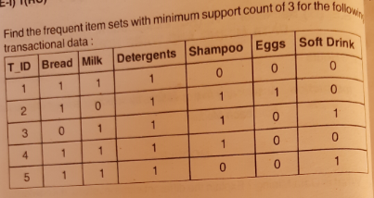

Slide 14
Frequent Itemset Generation Strategies to Reduce Complexity
Reduce the number of candidates (M)
Use pruning techniques to reduce M
Reduce the number of transactions (N)
Reduce size of N as the size of itemset increases
Reduce the number of comparisons (NM)
Use efficient data structures to store the candidates or compress the transaction dataset
No need to match every candidate against every transaction

Slide 15
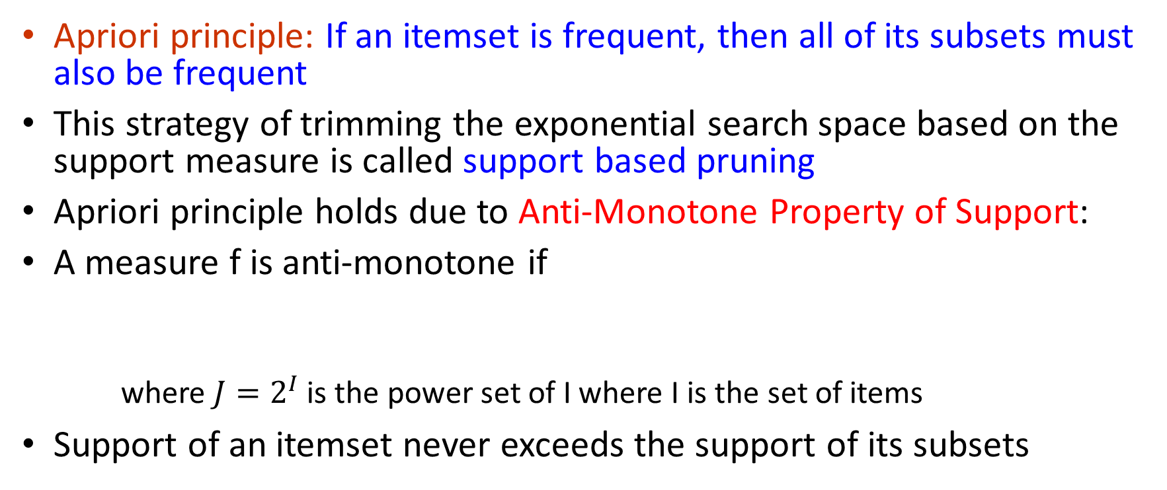

Reducing Number of Candidates
Apriori principle: If an itemset is frequent, then all of its subsets must also be frequent
This strategy of trimming the exponential search space based on the support measure is called support based pruning
Apriori principle holds due to Anti-Monotone Property of Support:
A measure f is anti-monotone if
where $J=2^{I}$ is the power set of I where I is the set of items
Support of an itemset never exceeds the support of its subsets
$$∀X,Y∈J:(X⊆Y)→f\left(X\right)≥f(Y)$$

Slide 16
Example
s(Bread) > s(Bread, Beer)
s(Milk) > s(Bread, Milk)
s(Diaper, Beer) > s(Diaper, Beer, Coke)

Slide 18
Illustrating Apriori Principle
Found to be Infrequent
Pruned supersets

Slide 19
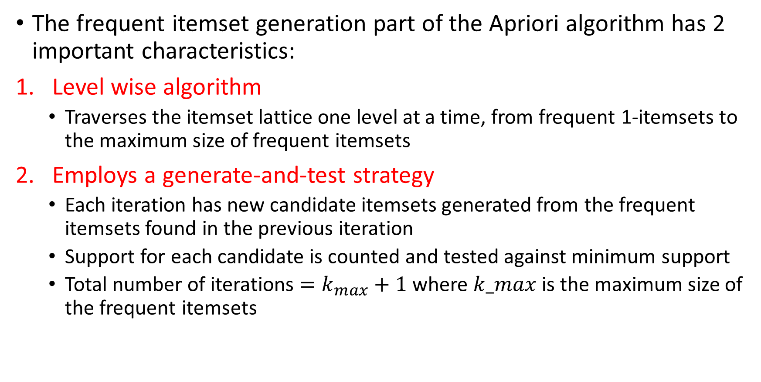
The frequent itemset generation part of the Apriori algorithm has 2 important characteristics:
Level wise algorithm
Traverses the itemset lattice one level at a time, from frequent 1-itemsets to the maximum size of frequent itemsets
Employs a generate-and-test strategy
Each iteration has new candidate itemsets generated from the frequent itemsets found in the previous iteration
Support for each candidate is counted and tested against minimum support
Total number of iterations $=k_{max}+1$ where $k_max$ is the maximum size of the frequent itemsets

Slide 20
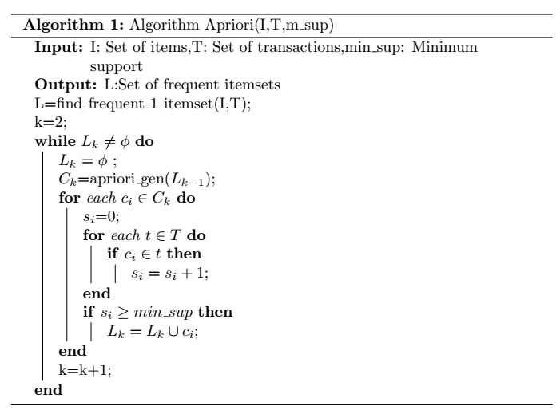

Slide 21
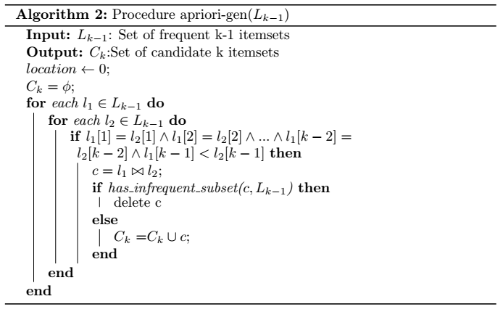

Slide 22
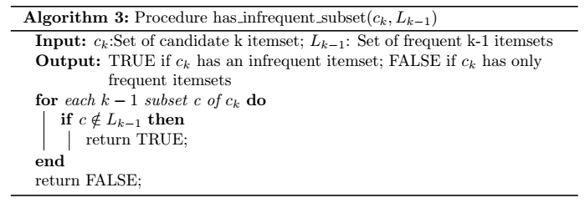

Slide 23
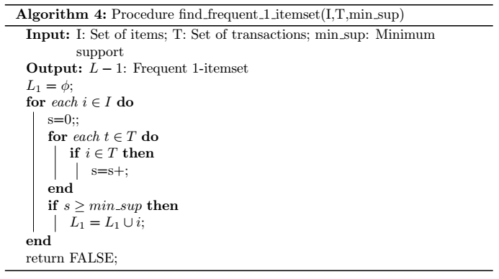

Slide 24
Illustrating Apriori Principle
Items (1-itemsets)
Pairs (2-itemsets)
(No need to generate candidates involving Coke or Eggs)
Minimum Support = 3
Triplets (3-itemsets)
If every subset is considered,
⁶C₁ + ⁶C₂ + ⁶C₃ = 41
With support-based pruning,
6 + 6 + 1 = 13

Slide 25
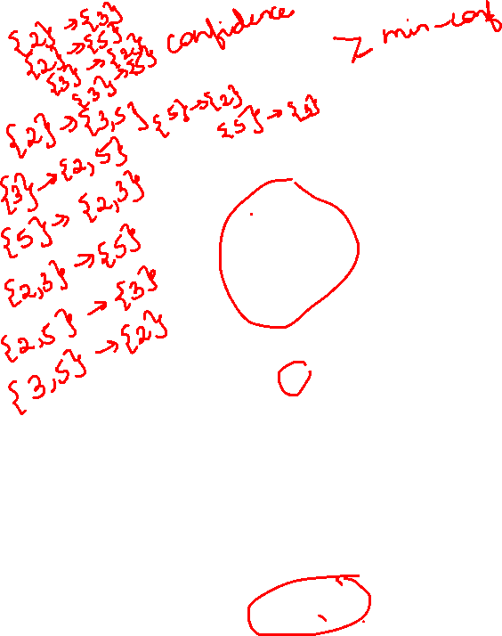
The Apriori Algorithm — Example
Database D
L₁
C₁
Scan D
min_sup=2=50%
C₂
C₂
L₂
Scan D
C₃
Scan D
L₃

Slide 26
Candidate Generation and Pruning
Apriori Algorithm does the following steps while generating candidate itemsets:
Candidate Generation: Generates C_{k} based on L_{k-1}
Candidate Pruning: Eliminates some of the itemsets in C_{k} with the support-based pruning strategy
Requirements of an effective candidate generation procedure:
A candidate itemset is unnecessary if atleast one of its subsets is infrequent
No frequent itemset should be left out by the candidate generation procedure
It should not generate the same candidate itemset more than once

Slide 27
Brute Force Method
Considers each k-itemset as a potential candidate and then applies the candidate pruning step to remove any unnecessary candidates
F_{k-1}xF_{k} Method
Extends each frequent (k-1)-itemset with other frequent items
May generate duplicate items
Can use lexicographic ordering to avoid duplicate itemsets
F_{k-1}xF_{k-1} Method
Merges a pair of (k-1)-itemsets only if their first (k-2) items are identical
An additional candidate pruning step is needed to ensure that the remaining k-2 subsets of the candidate are frequent

Slide 28
Support Counting
Process for determining the frequency of occurrence for every candidate itemset that survives the candidate pruning step of the apriori-gen function
One approach: Compare each transaction against each candidate itemset
Drawback: Computationally intensive especially when the number of transactions and candidate itemsets is very large
Alternative approach: Enumerate the itemsets in each transaction and use them to update the support count for each candidate itemset
Another approach:
Assume that each itemset can be enumerated by specifying the smallest item first, followed by the larger items
Enumerating 3-itemsets: 1 2 3 5 6 corresponds to itemsets beginning with 1 and 2, followed by 3, 5 or 6

Slide 29
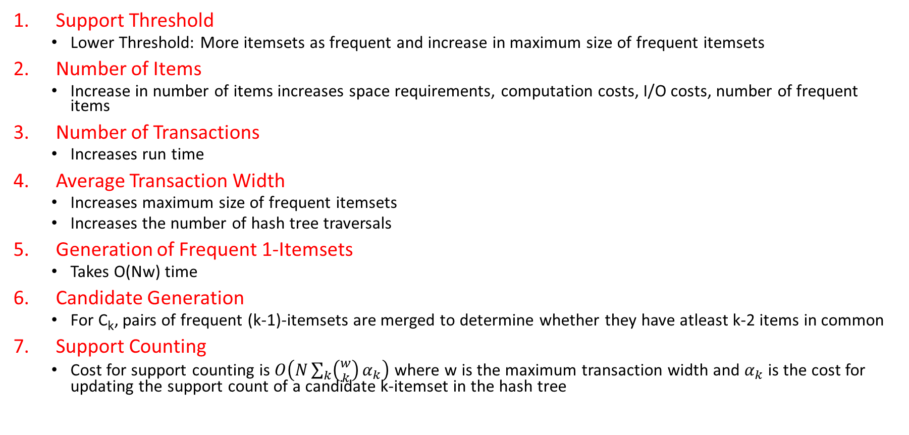
Factors Affecting Computational Complexity
Support Threshold
Lower Threshold: More itemsets as frequent and increase in maximum size of frequent itemsets
Number of Items
Increase in number of items increases space requirements, computation costs, I/O costs, number of frequent items
Number of Transactions
Increases run time
Average Transaction Width
Increases maximum size of frequent itemsets
Increases the number of hash tree traversals
Generation of Frequent 1-Itemsets
Takes O(Nw) time
Candidate Generation
For C_{k}, pairs of frequent (k-1)-itemsets are merged to determine whether they have atleast k-2 items in common
Support Counting
Cost for support counting is $O\left(N\sum_{k}{\left({w \atop k}\right)}α_{k}\right)$ where w is the maximum transaction width and $α_{k}$is the cost for updating the support count of a candidate k-itemset in the hash tree

Slide 30
Rule Generation

Slide 31
Rule Generation
How to efficiently generate rules from frequent itemsets?
In general, confidence does not have an anti-monotone property
c(ABC →D) can be larger or smaller than c(AB →D)
But confidence of rules generated from the same itemset has an anti-monotone property
e.g., L = {A,B,C,D}: c(ABC → D) ≥ c(AB → CD) ≥ c(A → BCD)
Confidence is anti-monotone w.r.t. number of items on the RHS of the rule
An association rule can be extracted by partitioning the itemset Y into two non-empty subsets, X and Y-X, such that X → Y-X satisfies the confidence threshold
Confidence Based Pruning
Theorem: If a rule X → Y-X does not satisfy the confidence threshold, then any rule X’ → Y-X’, where X is a subset of X, must not satisfy the confidence threshold as well

Slide 32
Rule Generation for Apriori Algorithm
Low Confidence Rule
Lattice of rules
Pruned Rules

Slide 33
Rule Generation
Given a frequent itemset L, find all non-empty subsets f ⊂ L such that f → L – f satisfies the minimum confidence requirement
If {A,B,C,D} is a frequent itemset, candidate rules:
ABC →D, ABD →C, ACD →B, BCD →A, A →BCD, B →ACD, C →ABD, D →ABC AB →CD, AC → BD, AD → BC, BC →AD, BD →AC, CD →AB,
If |L| = k, then there are 2^{k} – 2 candidate association rules (ignoring L → ∅ and ∅ → L)

Slide 34
Rule Generation for Apriori Algorithm
Candidate rule is generated by merging two rules that share the same prefix in the rule consequent
Joining (CD=>AB,BD=>AC) would produce the candidate rule D => ABC
Prune rule D=>ABC if its subset AD=>BC does not have high confidence

Slide 35
Is Apriori Fast Enough? — Performance Bottlenecks
The core of the Apriori algorithm:
Use frequent (k – 1)-itemsets to generate candidate frequent k-itemsets
Use database scan and pattern matching to collect counts for the candidate itemsets
The bottleneck of Apriori: candidate generation
Huge candidate sets:
10⁴ frequent 1-itemset will generate 10⁷ candidate 2-itemsets
To discover a frequent pattern of size 100, e.g., {a₁, a₂, …, a₁₀₀}, one needs to generate 2¹⁰⁰ ≈ 10³⁰ candidates.
Multiple scans of database:
Needs (n +1 ) scans, n is the length of the longest pattern

Slide 36
Maximal and Closed Itemsets

Slide 37
Compact Representation of Frequent Itemsets
Used to identify a small representative set of itemsets from which all other frequent itemsets can be derived
2 such representations:
Maximal Frequent Itemsets
Closed Frequent Itemsets

Slide 38
Maximal Frequent Itemset
Maximal Itemsets
An itemset is maximal frequent if none of its immediate supersets is frequent
Infrequent Itemsets
Border

Slide 39
Maximal Frequent Itemsets
Provide a compact representation of frequent itemsets: Form the smallest set of itemsets from which all frequent itemsets can be derived
Drawback:
Do not contain the support information of their subsets
Additional pass over the dataset is needed to determine the support counts of the non-maximal frequent itemsets

Slide 40
Closed Itemset
Provides a minimal representation of itemsets without losing their support information
An itemset is closed if none of its immediate supersets has the same support as the itemset

Slide 41
Maximal vs Closed Itemsets
Transaction Ids
Not supported by any transactions

Slide 42
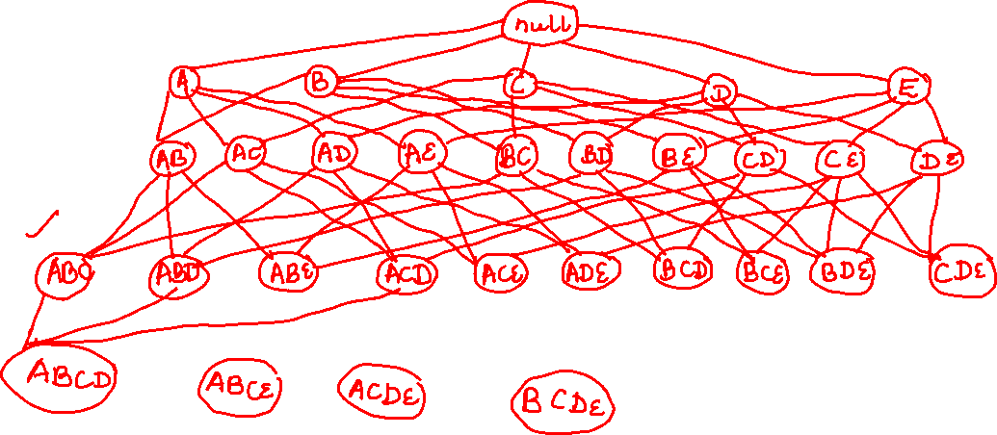

Slide 43
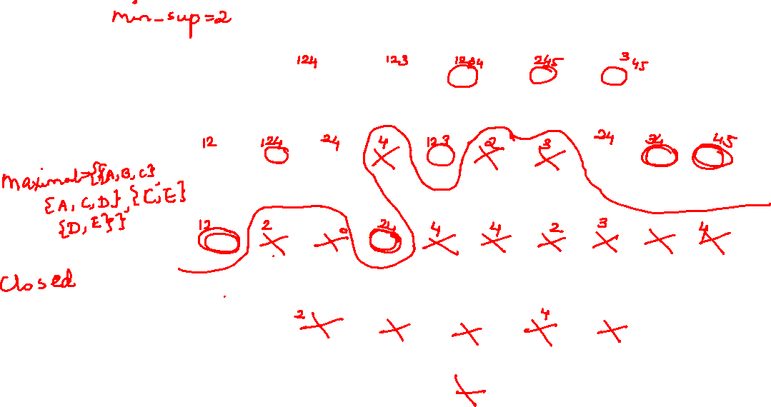

Slide 44

Maximal vs Closed Frequent Itemsets
Minimum support = 2
Closed but not maximal
Closed and maximal
# Closed = 9
# Maximal = 4

Slide 45
Closed Frequent Itemset: An itemset that is closed with support greater than or equal to minimum support
Advantages:
Useful for removing redundant rules
An association rule X->Y is redundant if there exists another rule X’->Y’ where X is a subset of X’, Y is a subset of Y’, support and confidence are identical for both rules
Such redundant rules are not generated if closed frequent itemsets are used for rule generation

Slide 46
Maximal vs Closed Itemsets

